Slide 1

Cambourne Village: a SUMMARY OF MAIN FINDINGS
Alex Jack, east sussex county council

Slide 2
Cambourne village: a SUMMARY OF MAIN FINDINGS
Outline of the project
Results from Cambourne – overall site
Results from internal sites
TRICS Technical note

Slide 3
AIM OF THE PROJECT
First survey of a new settlement – trip generation and modal split
Provide data that our users requested
Understand how sustainable a “sustainable development” actually is
Measure level of internalisation

Slide 4
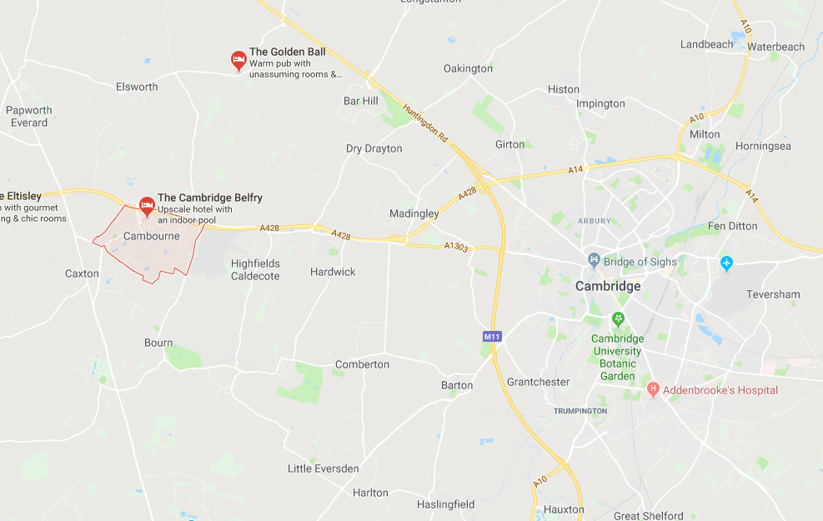
CAMBOURNE VILLAGE: LOCATION

Slide 5
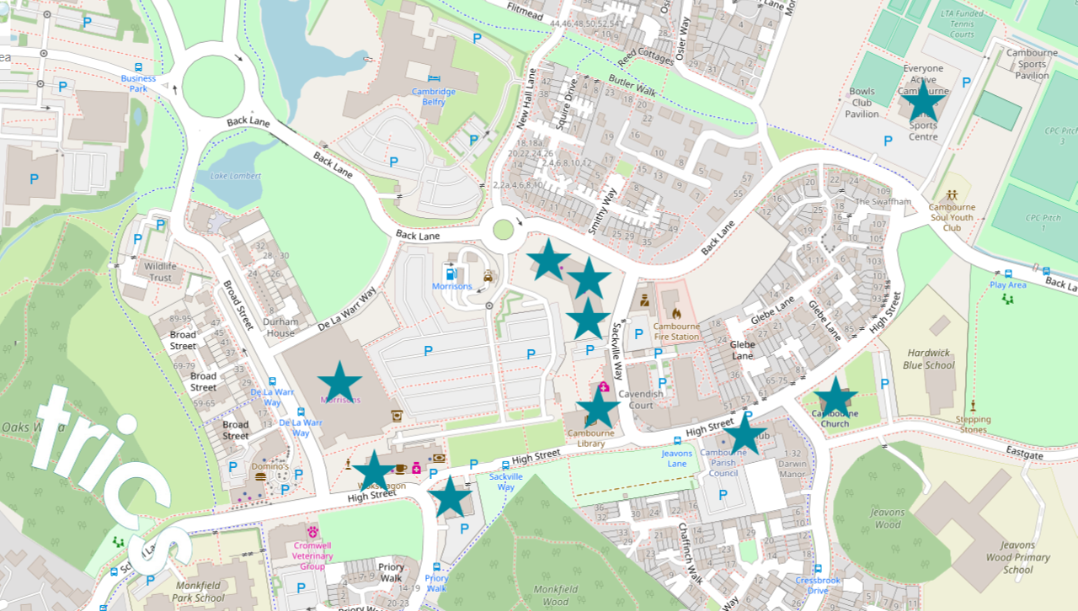
INTERNAL SITES

Slide 6
INTERNALISATION AND JOURNEY PURPOSE
Internalisation was a fundamental part of why we carried out the survey
Internal and external trips were split into:
  resident of Cambourne,
  employee of Cambourne,
  visitors to Cambourne,
  both residents AND employees of Cambourne.
Journey purpose was required for a fuller understanding of level of internalisation (or not)
Notes:
Modal split and trip generation levels
Sustainable credentials

Slide 7
CAMBOURNE: RESULTS FROM combined SITEs
Total trips (all time periods inbound and outbound combined) by mode – internal trips
Notes:
Just going to present you some initial results with no speculation about what they mean or any interpretation of them.
Very straightforward headline figures and not intended to be a detailed analysis of the results. That will come in a technical note published later this year.
This is just to whet your appetite for the full results and report.
Internal – peds relatively high. Cycles low

Slide 8
CAMBOURNE: RESULTS FROM combined SITEs
Total trips (all time periods inbound and outbound combined) by mode – external trips
Notes:
External peds low

Slide 9
CAMBOURNE: RESULTS FROM combined SITEs
Total trips (inbound and outbound separately) by mode at morning peak (0700-1000)
Internal Trips - Inbound
Internal trips - outbound
Notes:
Peds high for morning peak hour

Slide 10
CAMBOURNE: RESULTS FROM FROM combined SITEs
Total trips by mode at morning peak (0700-1000)
External Trips - Inbound
External trips - outbound
Notes:
External Trips - Inbound
Of the 86% (697) of external trips made by car with the morning peak period, 461 car trips were made by external visitors.
External Trips – Outbound
External trips outbound for visitors are increase during the morning peak period (and throughout the rest of the day). Visitor trips increase during the morning period, until midday and then increase again during the afternoon and evening. Work and work-live trips remain fairly constant with and increase of outbound trips during the midday period.

Slide 11
CAMBOURNE: RESULTS FROM combined SITEs
Total trips (inbound and outbound separately) by mode at evening peak (1600-1900)
Internal Trips - Inbound
Internal trips - outbound
Notes:
Internal – Inbound
Internal pedestrian trips inbound peak between 15:00-15:30, then drop significantly between 15:30-16:00 and then peak again at 16:00-16:30 before dropping off again.
Internal – Outbound
Car and pedestrian movements fluctuate throughout the day. Cycle trips increase between 15:00-18:00.

Slide 12
CAMBOURNE: RESULTS FROM combined SITEs
Total trips (inbound and outbound separately) by mode at evening peak (1600-1900)
External Trips - Inbound
External trips - outbound
Notes:
External – Inbound
The majority of external inbound trips in the evening period of 16:00-19:00 are made by visitors when researched the data of Person Trips by User Type. Of the 1,164 total trips within these three hours, 846 were made by visitors. 208 of the total trips were made by people who live in Cambourne.
External – Outbound
The peak in external outbound trips made by cars is made between 17:30-18:00. There is an increase in pedestrian trips between the period of 12:00-15:00.

Slide 13
CAMBOURNE: RESULTS FROM SURVEYED INTERNAL SITES
Morrison’s
Mode split for total internal trips (inbound and outbound)
Mode split for total external trips (inbound and outbound)
Notes:
7 internal sites surveyed
Not doing church as numbers so low. Same for community centre (everyone drove there) – will be in technical note in autumn
69% of the total car movements to Morrisons were made by external visitors.

Slide 14
CAMBOURNE: RESULTS FROM SURVEYED INTERNAL SITES
Morrison’s – total trips (inbound and outbound separately) by mode at morning peak (0700-1000)
Mode split for total trips (inbound)
Mode split for total trips (outbound)
Notes:
Total inbound trips made during the morning peak to Morrisons are dominated by car trips, at 76% (388 trips). There were only 5 bus trips during this same period.
Total outbound trips made during the morning period to Morrisons show similar results, with a slightly higher percentage of movements made by pedestrians at 21% compared to 17% through inbound trips.

Slide 15
CAMBOURNE: RESULTS FROM SURVEYED INTERNAL SITES
Morrison’s – total trips (inbound and outbound separately) by mode at evening peak (1600-1900)
Mode split for total trips (inbound)
Mode split for total trips (outbound)
Notes:
Total inbound trips made to Morrisons during the evening peak is again dominated by cars, being 76% (984 trips).
Total outbound trips made to Morrisons during the evening peak highlights the gradual increase in car trips to the site.

Slide 16
CAMBOURNE: RESULTS FROM SURVEYED INTERNAL SITES
Morrison’s – split of internal/external trips by mode (both directions and all time periods)
Internal trips
External trips
Notes:
Internal trips (covering both directions) to Morrisons throughout the day are mostly made by people who live in Cambourne, and can be seen to make peak visiting hours during 08:30-10:00, 12:00-14:00 and 17:00-18:00.
External trips made by visitors from outside Cambourne have much more prominence between the periods of 09:00-11:30 and from 15:30 onwards.

Slide 17
CAMBOURNE: RESULTS FROM SURVEYED INTERNAL SITES
Fitness Centre
Mode split for total internal trips (inbound and outbound)
Mode split for total external trips (inbound and outbound)

Slide 18
CAMBOURNE: RESULTS FROM SURVEYED INTERNAL SITES
Fitness Centre – total trips (inbound and outbound separately) by mode at morning peak (0700-1000)
Mode split for total trips (inbound)
Mode split for total trips (outbound)

Slide 19
CAMBOURNE: RESULTS FROM SURVEYED INTERNAL SITES
Fitness Centre – total trips (inbound and outbound separately) by mode at evening peak (1600-1900)
Mode split for total trips (inbound)
Mode split for total trips (outbound)

Slide 20
CAMBOURNE: RESULTS FROM SURVEYED INTERNAL SITES
Fitness Centre – split of internal/external trips by mode (both directions and all time periods)
Internal trips
External trips

Slide 21
CAMBOURNE: RESULTS FROM SURVEYED INTERNAL SITES
Library and Health Centre
Mode split for total internal trips (inbound and outbound)
Mode split for total external trips (inbound and outbound)

Slide 22
CAMBOURNE: RESULTS FROM SURVEYED INTERNAL SITES
Library & Health Centre – total internal trips (inbound and outbound separately) by mode at morning peak (0700-1000)
Mode split for total trips (inbound)
Mode split for total trips (outbound)

Slide 23
CAMBOURNE: RESULTS FROM SURVEYED INTERNAL SITES
Library & Health Centre – total trips (inbound and outbound separately) by mode at evening peak (1600-1900)
Mode split for total trips (inbound)
Mode split for total trips (outbound)

Slide 24
CAMBOURNE: RESULTS FROM SURVEYED INTERNAL SITES
Library & Health Centre – split of internal/external trips by mode (both directions and all time periods)
Internal trips
External trips

Slide 25
CAMBOURNE: RESULTS FROM SURVEYED INTERNAL SITES
Pets at Home
Mode split for total internal trips (inbound and outbound)
Mode split for total external trips (inbound and outbound)

Slide 26
CAMBOURNE: RESULTS FROM SURVEYED INTERNAL SITES
Pets at Home – total internal trips (inbound and outbound separately) by mode at morning peak (0700-1000)
Mode split for total trips (inbound)
Mode split for total trips (outbound)

Slide 27
CAMBOURNE: RESULTS FROM SURVEYED INTERNAL SITES
Pets at Home – total trips (inbound and outbound separately) by mode at evening peak (1600-1900)
Mode split for total trips (inbound)
Mode split for total trips (outbound)

Slide 28
CAMBOURNE: RESULTS FROM SURVEYED INTERNAL SITES
Pets at Home – split of internal/external trips by mode (both directions and all time periods)
Internal trips
External trips

Slide 29
CAMBOURNE: RESULTS FROM SURVEYED INTERNAL SITES
Poundworld
Mode split for total internal trips (inbound and outbound)
Mode split for total external trips (inbound and outbound)

Slide 30
CAMBOURNE: RESULTS FROM SURVEYED INTERNAL SITES
Poundworld– total internal trips (inbound and outbound separately) by mode at morning peak (0700-1000)
Mode split for total trips (inbound)
Mode split for total trips (outbound)

Slide 31
CAMBOURNE: RESULTS FROM SURVEYED INTERNAL SITES
Poundworld – total trips (inbound and outbound separately) by mode at evening peak (1600-1900)
Mode split for total trips (inbound)
Mode split for total trips (outbound)

Slide 32
CAMBOURNE: RESULTS FROM SURVEYED INTERNAL SITES
Poundworld – split of internal/external trips by mode (both directions and all time periods)
Internal trips
External trips
Notes:
Last internal site slide

Slide 33
CAMBOURNE VILLAGE: TECHNICAL ANALYSIS & PUBILSHED NOTE
Data for the whole Cambourne site is already available on TRICS database
Technical note to be published autumn 2019
Technical note will provide a factual analysis of what was observed at the Cambourne survey
Notes:
No speculation on reasons for results
Slides will be on the website if you want to look at this in more detail

